Slide 1
Welcome Intro to R

Slide 2
Welcome to Intro to R for decision modeling!

Slide 3
About the workshop module
R is a free, open-source software that provides a flexible environment for:
Data manipulation
Data visualization
Advanced statistical analyses
Programming
Report generation

Slide 4
Materials
All workshop materials can be downloaded from the workshop website:
https://decision-modeling-for-public-health.netlify.app/
We also have a Slack workspace:
https://join.slack.com/t/darthcdcdecis-lyt5179/shared_invite/zt-ild8x6xe-nmZqMaFQK9DC86tssB2GWw

Slide 5
Agenda
Completely asynchronous
Watch each video and work on the exercises in the worksheets (R Markdown templates)
You are encouraged to work with fellow participants
Solutions will be provided on Tuesday
Live Q & A session on Tuesday

Slide 6
What you will learn:
This module offers a comprehensive introduction to R for researchers working in healthcare.
By the end of this module, participants will be able to:
Write their own documents in R to perform standard tasks in health services research
Perform data cleaning and management within R
Create high quality plots for inclusion in publications
Simplify manuscript development with documents that integrate statistical analysis and report writing

Slide 7
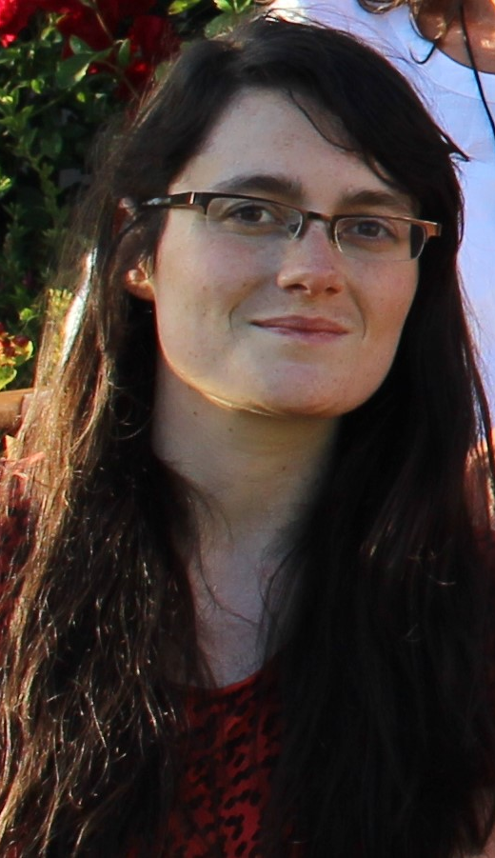
Intro to R Team
Petros Pechlivanoglou
Anna Heath
David Rios
Alan Yang

