Slide 1
The DARTH Workgroup
Decision Modeling for Public Health
November 2020

Slide 2
Decision Analysis in R for Technologies in Health (DARTH)
a multi-institutional collaboration of researchers
The aim:
  Expand knowledge in decision analysis, increase accessibiliy to decision modeling, and empower others to construct R-based decision models
Notes:
DARTH is a multi-institutional, multi-university collaboration of researchers with the aim to expand knowledge in decision analysis using open-source software, mainly R, and to develop educational material that empowers people to construct open-source-based decision models.

Slide 3
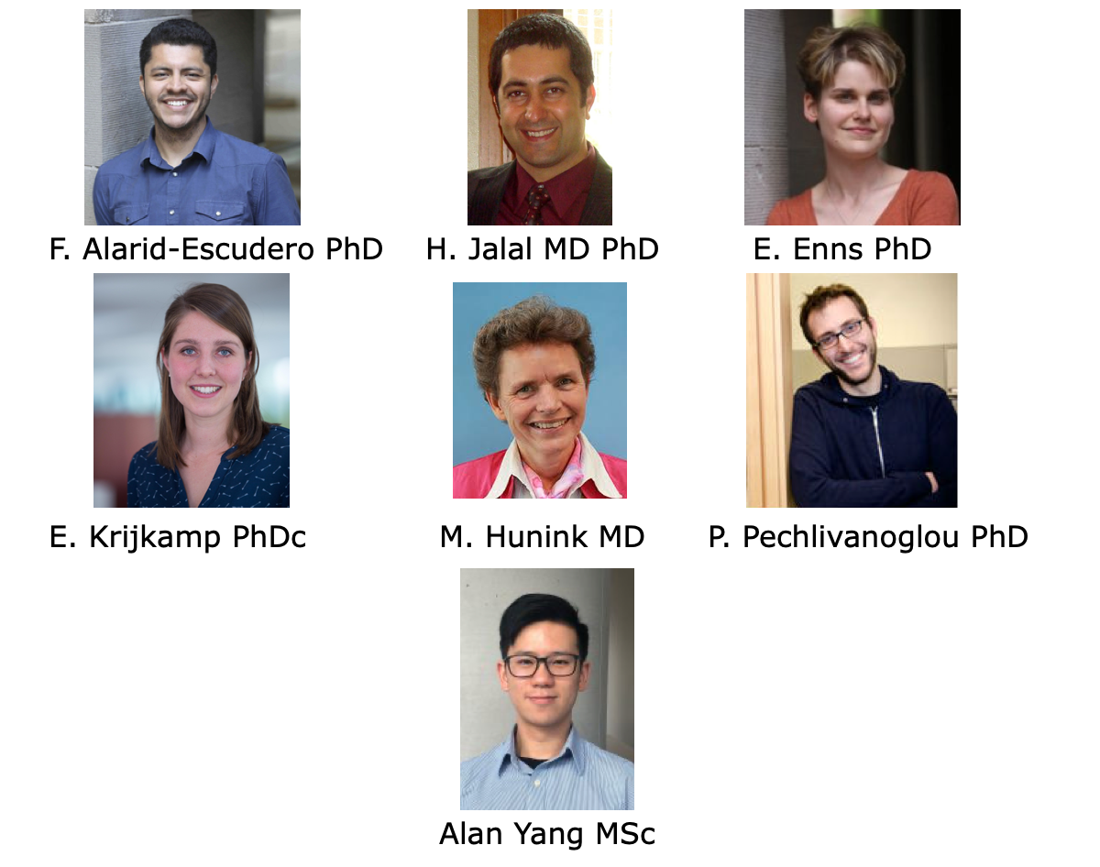
The DARTH workgroup
Notes:
The team consists of Fernando Alarid-Escudero from the University of Minnesota and his colleague from this university Eva Enns. We have Hawre Jalal from the University of Pittsburgh. Petros Pechlivanoglou working in the SickKids hospital in Toronto, Canada. Myriam Hunink and I are from the Erasmus Medical centre in Rotterdam.

Slide 4
Why R?
Freely available and open-source
Flexibility to implement any desired modeling structure
  Computationally efficient
Results are reproducible
  no “point-and-click” steps
Integrate statistical analyses with modeling
  Parameter estimation
  Analysis / visualization of results

Slide 5
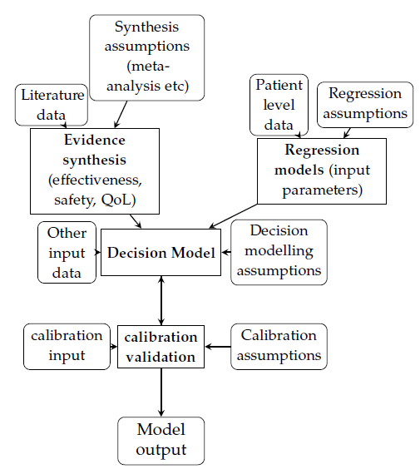








Conventional Decision Modeling Process
Notes:
Three main approaches
Specialized decision modeling software
TreeAge, Data, Crystal8, Arena etc.
Spreadsheet software
Microsoft Excel, Open/Libre Office
Statistical/ Computer programing software
Matlab, R, C++, Python, WinBUGS, etc

Slide 6
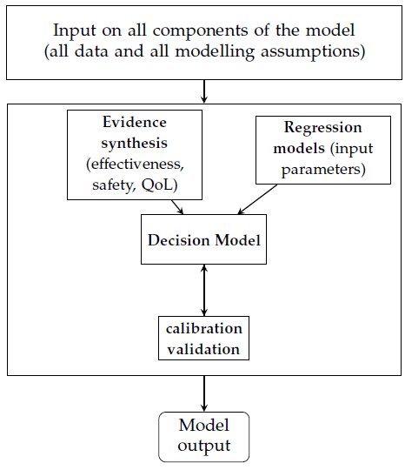
Streamlining Decision Modeling

Slide 7
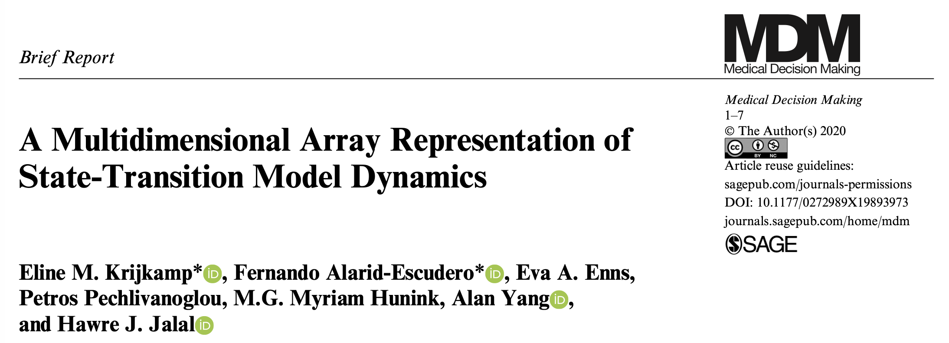
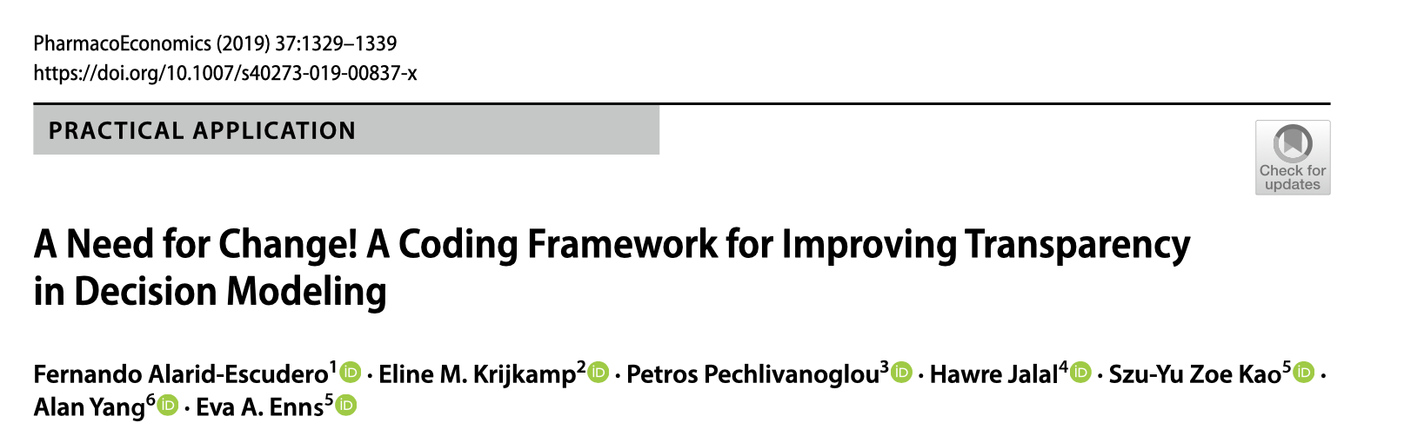
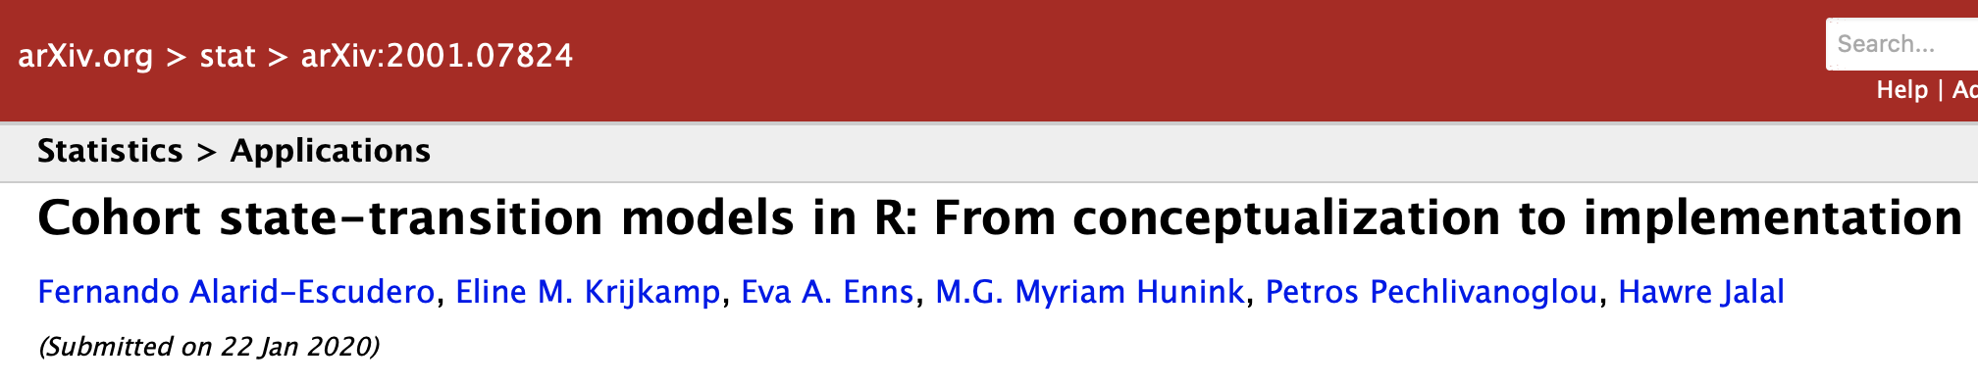
DARTH Publications

Slide 8
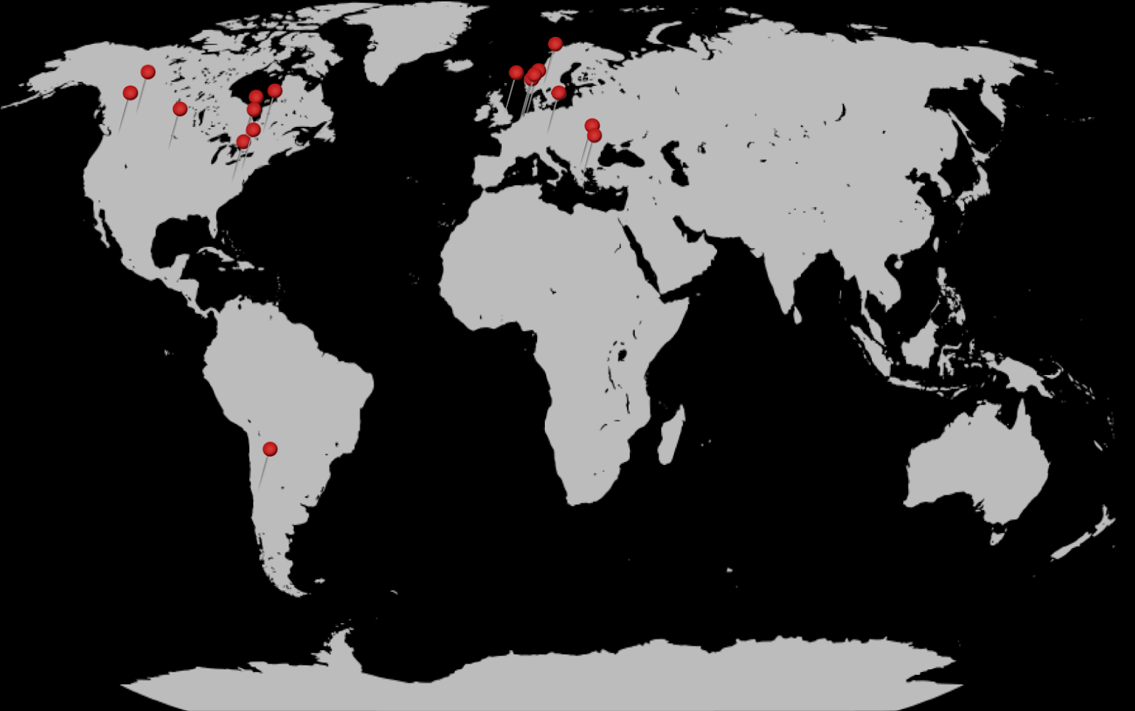
DARTH Workshops 2016-2020
Learn with DARTH: http://darthworkgroup.com/workshops/
22 workshops
550 participants
Notes:
The team consists of Fernando Alarid-Escudero from the University of Minnesota and his colleague from this university Eva Enns. We have Hawre Jalal from the University of Pittsburgh. Petros Pechlivanoglou working in the SickKids hospital in Toronto, Canada. Myriam Hunink and I are from the Erasmus Medical centre in Rotterdam.

Slide 9


Slide 10
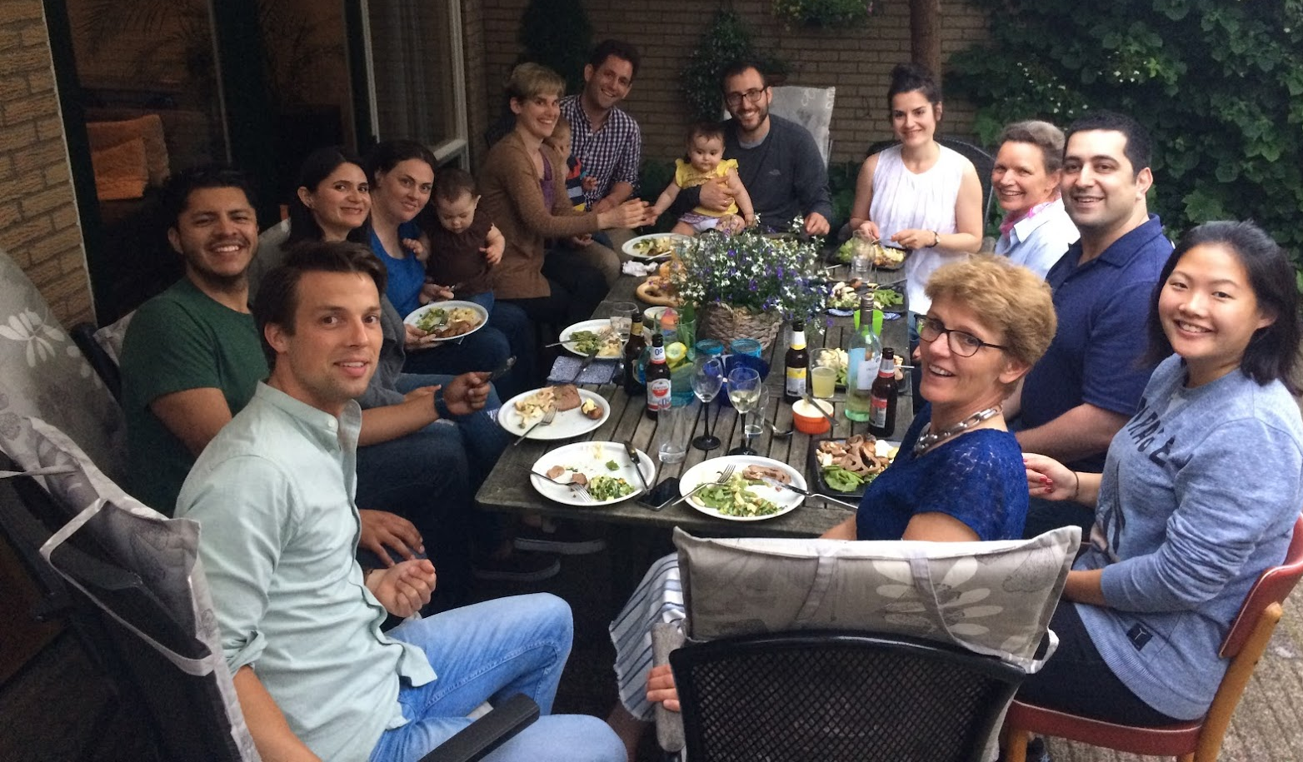
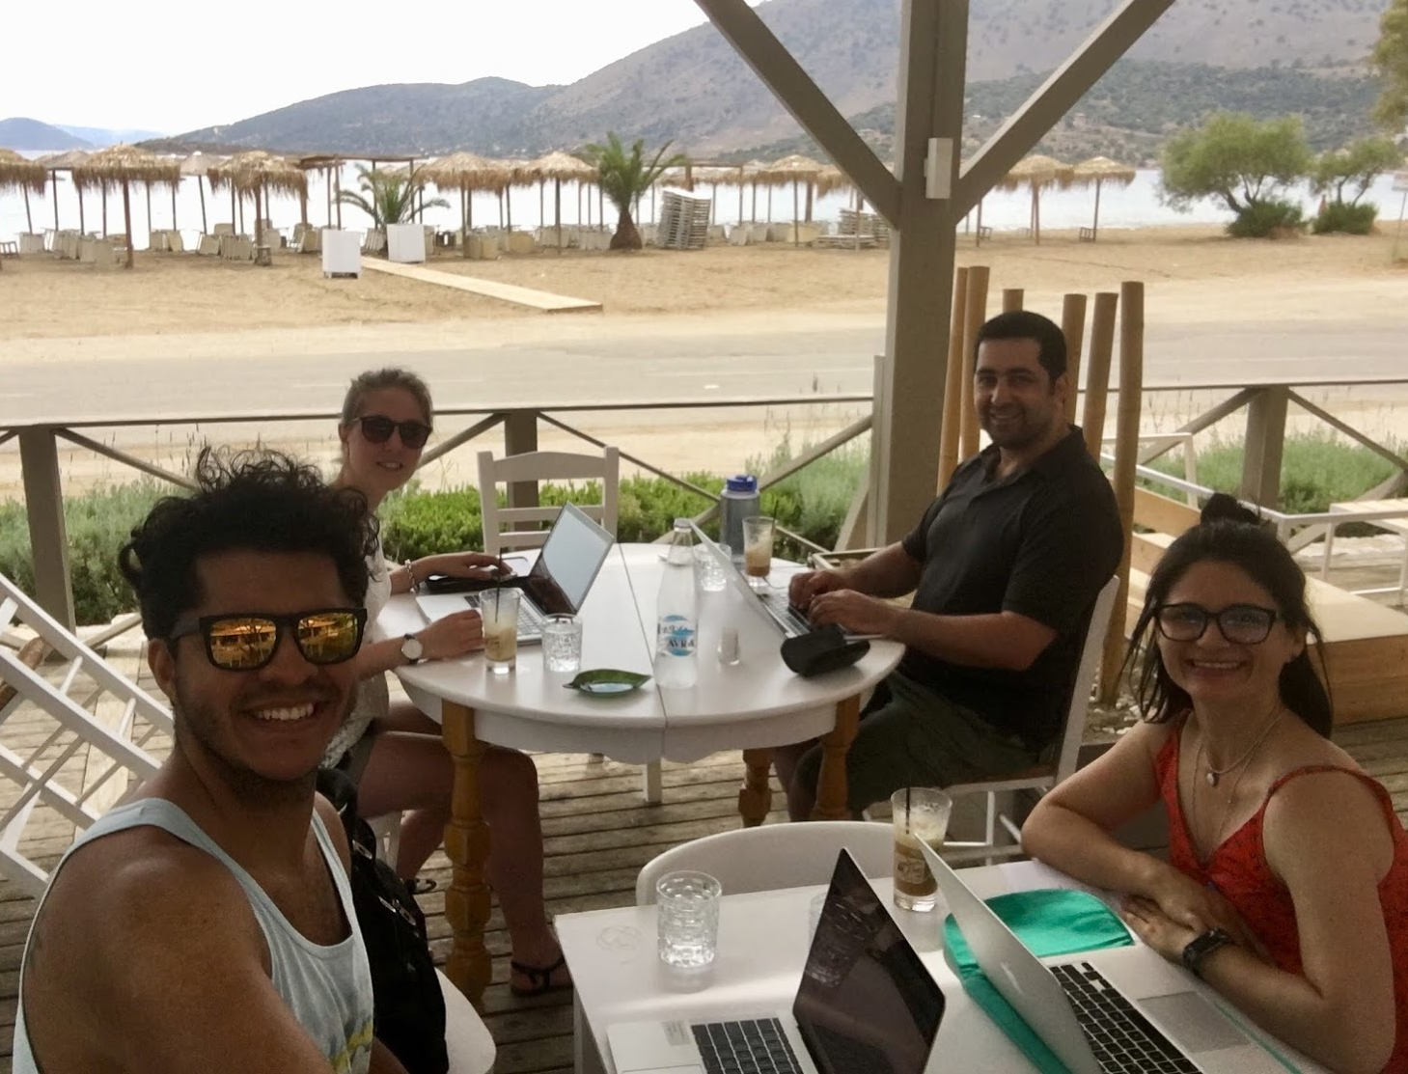
Mediterranean Sea
R code!!!

Slide 11
Course Logistics:
Decision Modeling for Public Health
Notes:
Part 1 = Showing code 3 state model
Part 2 = Exercise build Sick-Sicker model
Part 3 = Show answers of Sick-Sicker

Slide 12
Schedule
Part I: Introduction and foundations of decision modeling in R
  Mon Nov 2 – Fri Nov 6
Part II: Advanced decision modeling in R
  Mon Nov 9 – Tues Nov 10
Synchronous Zoom sessions will be held each morning from 9:00AM – 12:00PM EST
Slack support will be offered each afternoon from 1:00PM – 4:00PM EST

Slide 13
Course Resources
All course materials can be found on the course website
  Recorded lectures
  Slides
  R markdown files
Synchronous Zoom sessions
  Before class: watch the appropriate lecture series
  In-class: We’ll guide you through sample R code and hands-on exercises
Slack workspace
  Ask questions, introduce yourself

Slide 14
Learning objectives
By the end of the workshop, participants will be able to
Create decision models using R (cohort, microsimulation models, etc)
Understand the advantages and disadvantages of different types of models
Apply good coding practice in R
Create transparent and readable decision models
Apply the methods learned to real-life practical examples

Slide 15
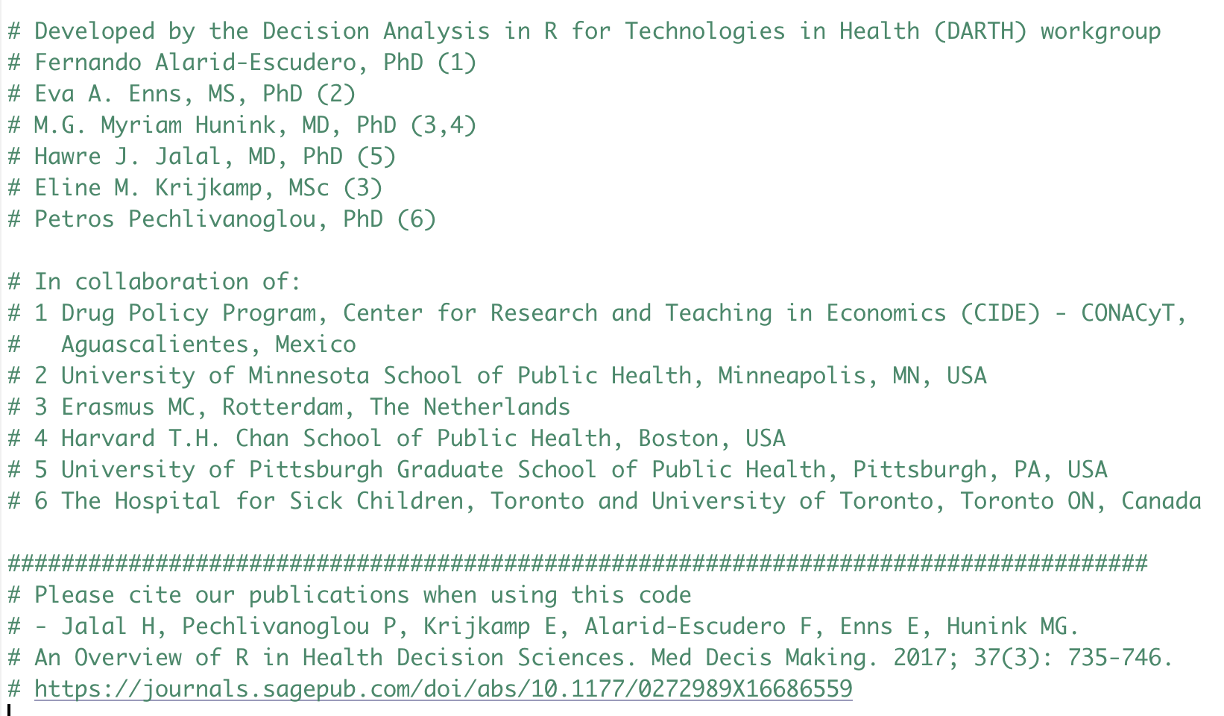
Attribution and Acknowledgement
R code provided with this course are yours to reuse and modify
Acknowledgement and citation information in code headers

Slide 16
Notes:
I like to thank you very much for your attention and I would be happy to take any questions know or find me during the lunch break

