Slide 1
dampack: A flexible R package for analyzing and visualizing cost-effectiveness analysis results
Eva A. Enns¹, Caleb Easterly², Zoe Kao¹, Greg Knowlton¹, Eline Krijkamp³, Petros Pechlivanolgou⁴, Hawre Jalal⁵, Fernando Alarid-Escudero⁶
1. University of Minnesota School of Public Health 2. University of North Carolina School of Medicine
3. Erasmus University Medical Center 4. The Hospital for Sick Children
5. University of Pittsburgh Graduate School of Public Health 6. Centro de Investigación y Docencia Económicas

Slide 2
Funding and Disclosures
Funding provided by the National Institute of Allergy and Infectious Diseases of the National Institutes of Health
  R01-AI38783 (PI: Jenness), K25-AI118476 (PI: Enns)
  The content is solely the responsibility of the authors and does not represent the official views of the National Institutes of Health.
No conflicts of interest to disclose

Slide 3
Motivation
Growing use of R for decision analytic modeling and cost-effectiveness analysis (CEA)
  Computation efficiency
  Transparency
  Freely available
Unmet need for CEA visualization tools in R

Slide 4
Introducing dampack
R package available on GitHub: ‘DARTH-git/dampack’
Functionality:
  Incremental cost-effectiveness analysis
  One- and two-way sensitivity analyses visualization
  Quantifying decision uncertainty (cost-effectiveness acceptability curve / expected loss curves)
  Value of information analysis

Slide 5
Interfacing with dampack
Results visualization
  Deterministic or derived from PSA dataset
  Incremental cost-effectiveness ratios
  Cost-effectiveness plane
  One-way and two-way sensitivity analysis
Deterministic results
dampack
Probabilistic sensitivity analysis (PSA) dataset
Uncertainty analysis
  Requires PSA dataset
  Cost-effectiveness acceptability curve
  Expected loss curves
  Value of information analysis

Slide 6
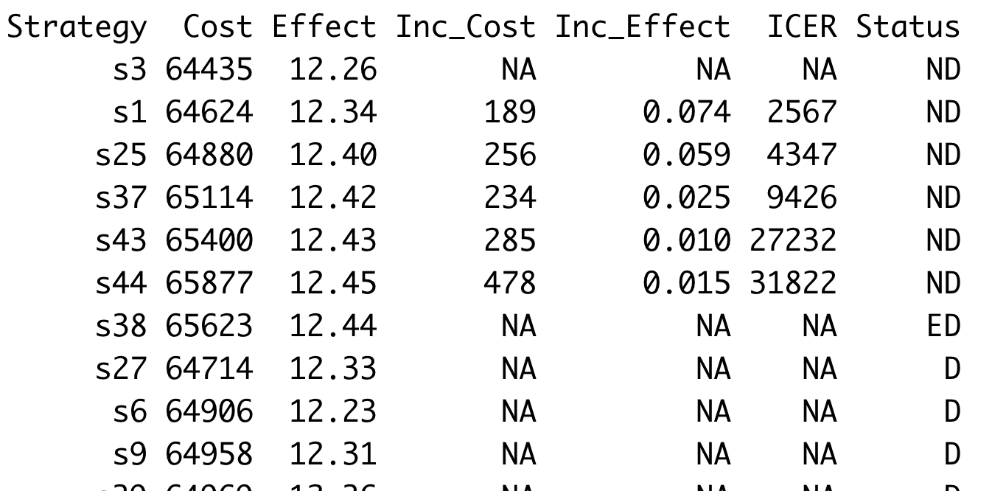
Results visualization with dampack
Cost-effectiveness table
  Identification of dominated strategies
  Calculation of incremental cost-effectiveness ratios (ICERs)
Strategies on the efficient frontier and associated ICERs
Dominated strategies and type of dominance

Slide 7
Results visualization with dampack
Cost-effectiveness plane and efficient frontier
Run calculate_icers() to create a data object of class ICER.
← Generated automatically by calling:
plot(ICER object)

Slide 8
Results visualization with dampack
Deterministic sensitivity analyses
Direct input from user
  Table of outcomes for each strategy as parameters vary
Derived from user-provided PSA dataset
  Fit linear meta-model to PSA data
  Reflects univariate and/or bivariate relationships between outcomes and parameters of interest

Slide 9
Results visualization with dampack
Deterministic one-way sensitivity analyses

Slide 10
Results visualization with dampack
Two-way sensitivity analyses

Slide 11
Uncertainty analysis with dampack
Cost-effectiveness acceptability curve and frontier

Slide 12
Uncertainty analysis with dampack
Expected loss curves and frontier

Slide 13
Uncertainty analysis with dampack
Expected value of perfect information (EVPI)

Slide 14
Uncertainty analysis with dampack
Expected value of partial perfect information (EVPPI)

Slide 15
Continuing work
Implementation of more advanced value of information analyses (EVPPI, EVSI)
Functionality to generate deterministic or probabilistic sensitivity analysis by calling a user-defined function
Functions to support sampling of parameters for PSA, including correlated parameters
Continued user testing of existing functionality

Slide 16

How you can help
Download dampack and try it out
User feedback is appreciated!
Submit issues or feature requests via Github or email
  eenns@umn.edu; fernando.alarid@cide.edu

Slide 17
Questions?
Website: darthworkgroup.com
Github: github.com/DARTH-git

